Slide 1

Cloud Computing and Distributed Systems
Session-4 (Week-5)
Mayank Taneja,
Teaching Assistant

Slide 2
Q. 1 Consider the following statements:
Statement 1: A protocol for an asynchronous system will also work for a synchronous system (but not vice-versa).
Statement 2: In the asynchronous system model, whatever protocol/algorithm you suggest, there is always a worst-case possible execution (with failures and message delays) that prevents the system from reaching consensus.
Statement 3: Paxos doesn’t provide safety and eventual liveness.
A. Only Statement 1 is true
B. Only Statement 1 and statement 2 are true
C. Only Statement 2 and statement 3 are true
D. Only Statement 3 is true

Slide 3
Synchronous Distributed System
Each message is received within bounded time
Drift of each process’ local clock has a known bound
Each step in a process takes lb < time < ub
Asynchronous Distributed System
No bounds on process execution
The drift rate of a clock is arbitrary
No bounds on message transmission delays
This is a more general (and thus challenging) model than the synchronous system model.
A protocol for an asynchronous system will also work for a synchronous system (but not vice-versa)

Slide 4
In the synchronous system model:
Consensus is solvable
In the asynchronous system model:
Consensus is impossible to solve
Whatever protocol/algorithm you suggest, there is always a worst-case possible execution (with failures and message delays) that prevents the system from reaching consensus
FLP Proof
Paxos is asynchronous consensus-solving algorithm
Does not solve consensus problem fully (asynchronous)
But provides safety and eventual liveness.
Safety: Consensus is not violated
Eventual Liveness: If things go well sometime in the
future (messages, failures, etc.), there is a good chance
consensus will be reached. But there is no guarantee.

Slide 5
Q. 2 Find out the correct model for the given assumptions of a system:
Assumption 1: No bounds on process execution
Assumption 2: The drift rate of a clock is arbitrary
Assumption 3: No bounds on message transmission delays
A. Asynchronous distributed system
B. Synchronous distributed system
C. On demand computing system
D. Parallel processing system

Slide 6
Answer: A) Asynchronous distributed system
Explanation: Asynchronous Distributed System has following properties:
1. No bounds on process execution
2. The drift rate of a clock is arbitrary
3. No bounds on message transmission delays
E.g., The Internet is an asynchronous distributed system, so are ad-hoc and sensor
networks

Slide 7
Q. 3 Choose the correct items for X, Y, and Z.
X is widely used implementation of a safe, Y consensus protocol for Z systems
A. X- Leader election, Y- eventually-live, Z- synchronous
B. X- Paxos protocol, Y- eventually-live, Z- asynchronous
C. X- Apache Zookeeper, Y- consistent, Z- asynchronous
D. X- Paxos protocol, Y- consistent, Z- synchronous

Slide 8
Answer: B) X- Paxos protocol, Y- eventually-live, Z- asynchronous
Explanation: Paxos protocol is widely used implementation of a safe, eventually-live
consensus protocol for asynchronous systems. Paxos (or variants) used in Apache
Zookeeper, Google’s Chubby system, Active Disk Paxos, and many other cloud
computing systems

Slide 9
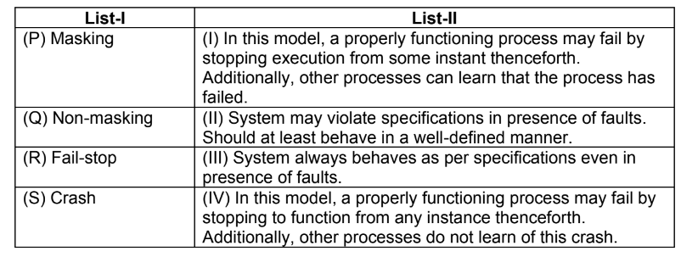
Q. 4 Match the following two list:
A. (P): I, (Q): II, (R): III, (S): IV
B. (P): III, (Q): IV, (R): II, (S): I
C. (P): II, (Q): I, (R): IV, (S): III
D. (P): III, (Q): II, (R): I, (S): IV

Slide 10
Type of Process Failure Models
Fail-stop: In this model, a properly functioning process may fail by stopping execution from some instant thenceforth. Additionally, other processes can learn that the process has failed.
Crash: In this model, a properly functioning process may fail by stopping to function from any instance thenceforth. Unlike the fail-stop model, other processes do not learn of this crash.
Receive omission: A properly functioning process may fail by intermittently receiving only some of the messages sent to it, or by crashing.
Send omission: A properly functioning process may fail by intermittently sending only some of the messages it is supposed to send, or by crashing.
General omission: A properly functioning process may fail by exhibiting either or both of send omission and receive omission failures.
Byzantine or malicious failure: In this model, a process may exhibit any arbitrary behavior and no authentication techniques are applicable to verify any claims made.

Slide 11
Fault Tolerance
Masking – System always behaves as per specifications even in presence of faults.
Non-masking– System may violate specifications in presence of faults. It merely guarantees that when faults stop occurring, program execution converge to states from which program continually resatisfy their specification.

Slide 12
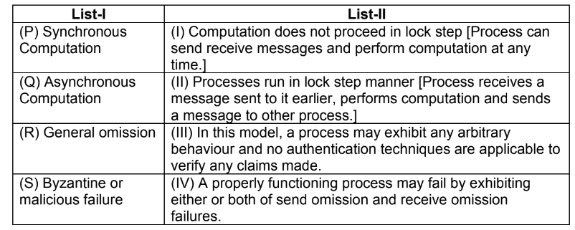
Q. 5 Match the following two list:
A. (P): I, (Q): II, (R): III, (S): IV
B. (P): III, (Q): IV, (R): II, (S): I
C. (P): II, (Q): I, (R): IV, (S): III
D. (P): III, (Q): II, (R): I, (S): IV

Slide 13
Answer: C) (P): II, (Q): I, (R): IV, (S): III
Synchronous Computation:
Processes run in lock step manner [Process receives a message sent to it earlier, performs computation and sends a message to other process.]
Step of Synchronous computation is called ‘round’
Asynchronous Computation:
Computation does not proceed in lock step.
Process can send receive messages and perform computation at any time.

Slide 14
Q. 6 Find out the correct problem for the following problem specification:
Agreement: All non-faulty processes must agree on the same (single) value.
Validity: If all the non-faulty processes have the same initial value, then the agreed upon value by all the non-faulty processes must be that same value.
Termination: Each non-faulty process must eventually decide on a value.
A. Byzantine Agreement Problem
B. Consensus Problem
C. Interactive Consistency Problem
D. None of the above

Slide 15
Problem Specifications
Byzantine Agreement Problem (single source has an initial value)
Agreement: All non-faulty processes must agree on the same value.
Validity: If the source process is non-faulty, then the agreed upon value by all the non-faulty processes must be the same as the initial value of the source.
Termination: Each non-faulty process must eventually decide on a value.
Consensus Problem (all processes have an initial value)
Agreement: All non-faulty processes must agree on the same (single) value.
Validity: If all the non-faulty processes have the same initial value, then the agreed upon value by all the non-faulty processes must be that same value.
Termination: Each non-faulty process must eventually decide on a value.
Interactive Consistency Problem (all processes have a set of initial values)
Agreement: All non-faulty processes must agree on the same array of values A[v1 . .. vn ].
Validity: If process i is non-faulty and its initial value is vi then all non-faulty processes agree on vi as the i th element of the array A. If process j is faulty, then the non-faulty processes can agree on any value for A[ j ].
Termination: Each non-faulty process must eventually decide on the array A.

Slide 16
Q. 7 True or False ?
Consider the following statement:
The difference between the agreement problem and the consensus problem is that, in the agreement problem, all processes have an initial value, whereas in the consensus problem, a single process has the initial value.
A) True
B) False

Slide 17
Answer: A) True
Explanation: The correct statement is: The difference between the agreement problem and the consensus problem is that, in the agreement problem, a single process has the initial value, whereas in the consensus problem, all processes have an initial value.

Slide 18
Consider the following statement:
In a system of n processes, the Byzantine agreement problem (as also the other variants of the agreement problem) can be solved in a synchronous system only if the number of Byzantine processes f is such that
A) f <= ⌊(n-1)/2⌋
B) f <= ⌊(n-1)/3⌋
C) f < ⌊(n-1)/2⌋
D) f < ⌊(n-1)/3⌋

Slide 19
Byzantine agreement problem cannot be solved in a synchronous system, having 3m+1 nodes, where >m nodes are byzantine
it is impossible to reach an agreement if number of faulty processes f exceeds (n-1)/3 where n is number of processes
f <= ⌊(n-1)/3⌋

Slide 20
Q. 9 In ______________________, processes coordinate their checkpoints in order to
save a system-wide consistent state. This consistent set of checkpoints can be used
to bound the rollback.
A. Uncoordinated Checkpointing
B. Coordinated Checkpointing
C. Communication-induced Checkpointing
D. None of the above

Slide 21
Checkpoint Based Recovery
Uncoordinated Checkpointing: Each process takes its checkpoints independently.
Coordinated Checkpointing: Processes coordinate their checkpoints in order to save a system-wide consistent state.This consistent set of checkpoints can be used to bound the rollback.
Communication-induced Checkpointing: It forces each process to take checkpoints based on information piggybacked on the application messages it receives from other processes.

Slide 22
Q. 10 ____________________ is a cascaded rollback which causes the system to roll back to too far in the computation (even to the beginning), in spite of all the checkpoints.
A. Rollback
B. Phantom Effect
C. Domino Effect
D. Livelock problem

Slide 23
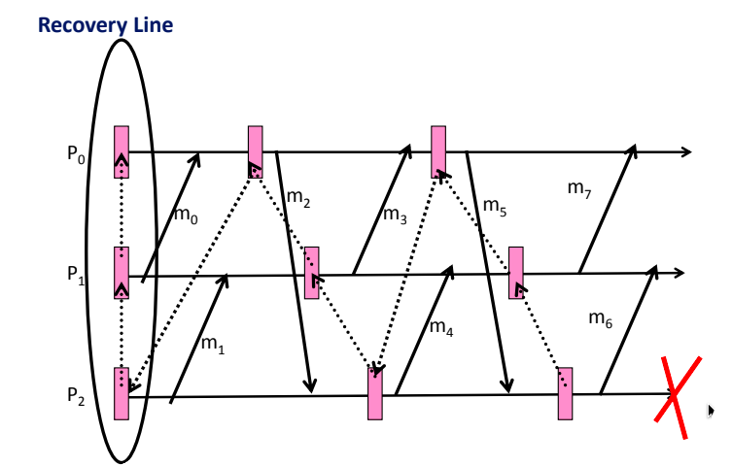
Answer: C) Domino Effect
Explanation: Domino Effect: Cascaded rollback which causes the system to roll
back to too far in the computation (even to the beginning), in spite of all the
checkpoints.

